Slide 1

CSE 465 - Pattern Recognition and Neural Networking
Talbia Kabir ID - 1521165042

Slide 2

“Automatic Character Identification System From Video”
Based on: Convolutional Neural Network (CNN)

Slide 3
DESCRIPTION
This work aims to realize a recognition system for a software engine that will automatically detect character using Convolutional Neural Networks (CNNs) from a video content. This system actually includes tracking a certain character from any content like TV show, cinema, or any other source and to count how many times the character is in frames. The main part of the work is:
Detecting and identifying characters from any videos or movies
Tracking and clustering faces from videos and extracting names from script
Counting how many times a character is entering in the frame

Slide 4
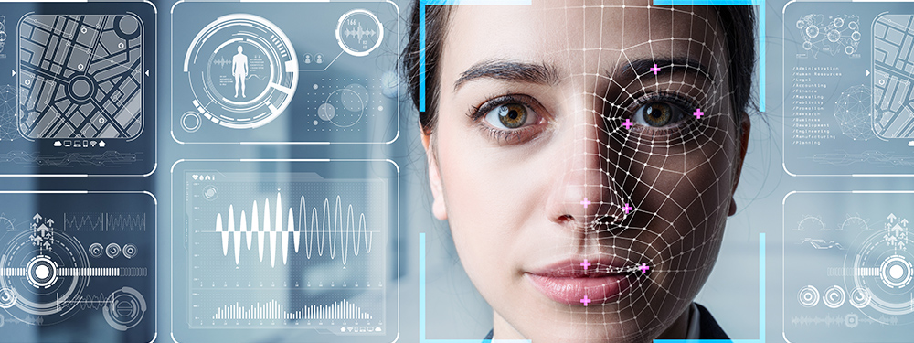
FACE RECOGNITION SYSTEM
The face recognition system generally involves two stages:
Face Detection – where the input image is searched to find any face, then image processing cleans up the facial image for easier recognition.
Face Recognition – where the detected and processed face is compared to the database of known faces to decide who that person is.

Slide 5
LIBRARIES
For the face recognition in both images and video streams, the libraries I have used:
NumPy
Pandas
Matplotlib
Keras
Skimage
OpenCV
To perform face recognition with Python and OpenCV, I used two additional libraries:
The Dlib library contains implementation of “deep metric learning” to construct face embeddings used for the actual recognition process.
The Face_Recognition library wraps around dlib’s facial recognition functionality that makes it easier to work with.

Slide 6
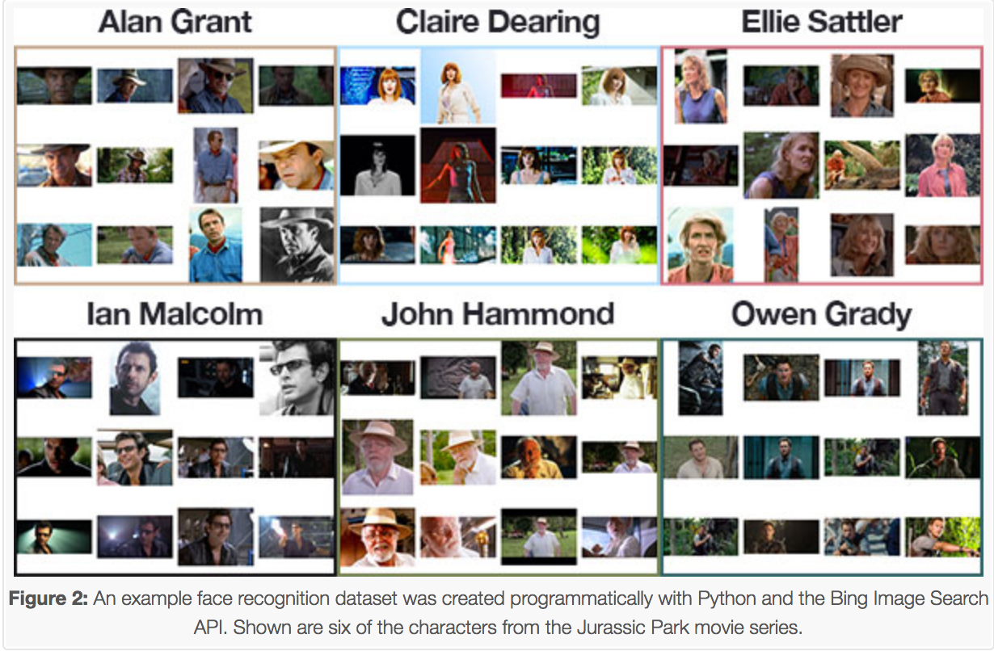
DATASET
The face recognition dataset was created programmatically with Python and the Bing Image Search API. Given this dataset of images,
Created the 128-d embeddings for each face in the dataset
Used these embeddings to recognize the faces of the characters in both images and video streams

Slide 7
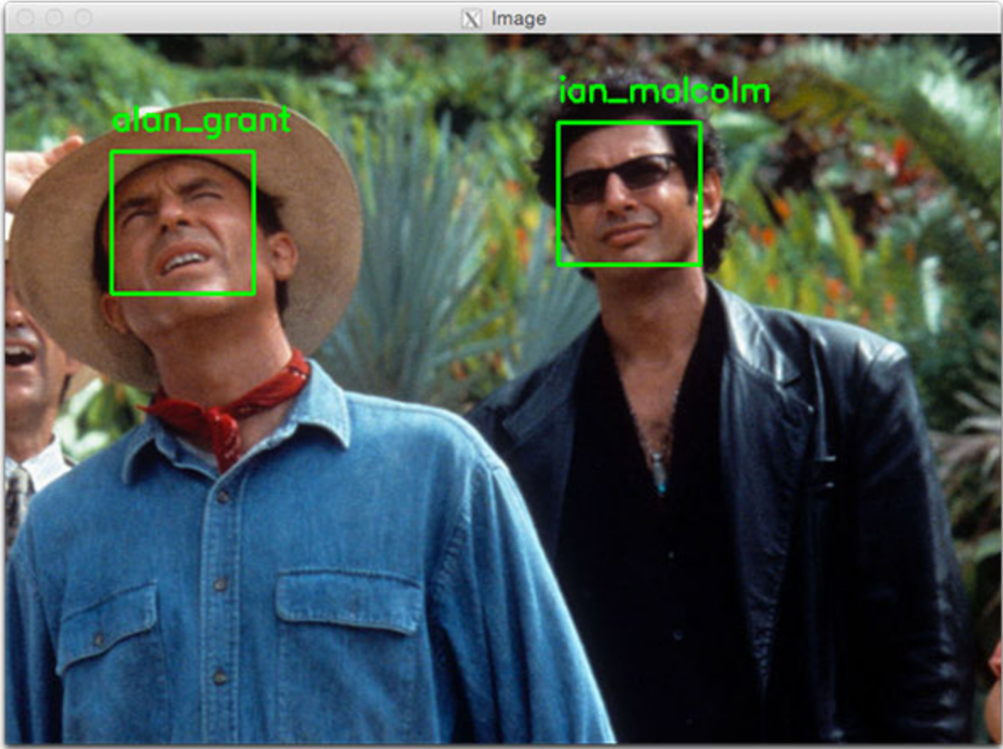
DETECTION and EXTRACTING FRAMES
Before encoding faces in images, first I needed to detect them. Two face detection methods either HOG (Histogram of Oriented Gradients) or CNN (Convolutional Neural Network) are used for detection method.
Here, I used Jurassic Park movies’ clips to capture the video from the given directory using the VideoCapture() function, and then extracted frames from the video and saved them as an image using the imwrite() function.

Slide 8
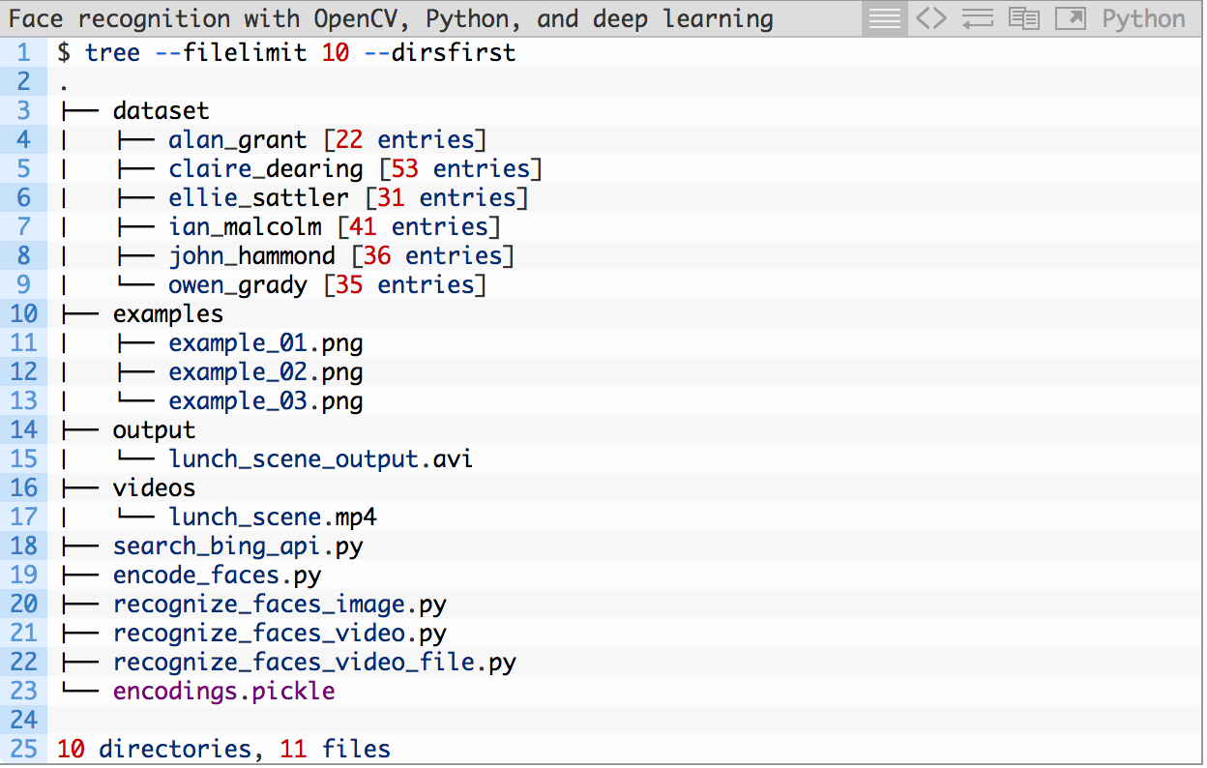
PROJECT STRUCTURE
Project structure can be seen by examining the output from the tree command:
It has 4 top-level directories:
dataset/
examples/
output/
videos/
And 6 root level directories.

Slide 9
UPDATE: MODEL BUILDING
from keras.models import Sequential
from keras.applications.vgg16 import VGG16
from keras.layers import Dense, InputLayer, Dropout
I loaded the VGG16 pre-trained model and store it as base_model: Divided into 3 sub-steps to build the model:
Building the model
Compiling the model
Training the model
I used VGG16 pre-trained model which takes an input image of shape (224 X 224 X 3).
Since the images are in a different size, I needed to reshape all of them. For this reason, I used the resize() function of skimage.transform to do this.

Slide 10
CALCULATING SCREEN TIME
We preprocessed the images, by using the base_model.predict() function.
Reshape these images to 1-D form, and make them zero-centered.
Make predictions for the remaining images
Calculate the screen time for each character

Slide 11
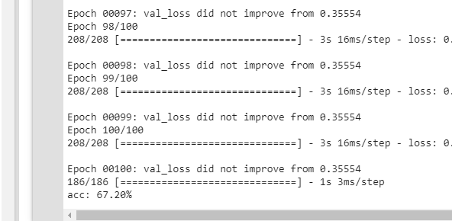
ACCURACY
I got an accuracy of around 54% on the test data using this model.
acc: 53.68%

Slide 12
DIFFICULTIES
For face detection, at first I used HOG (Histogram of Oriented Gradients) method but I did not get an accurate result. Then I used CNN (Convolutional Neural Network) to make it work.
I tried using the pre-trained model without removing the top layer. The results were not satisfactory. To tackle this problem, I retrained the model using few labelled images and the results were better than the previous results.

Slide 13
THANK YOU !!

